Slide 1





How can Airbnb data inform travel plans?
Travel accommodation recommendation based on quantitative data analysis & visualization
By: Zhané Bennett

Slide 2
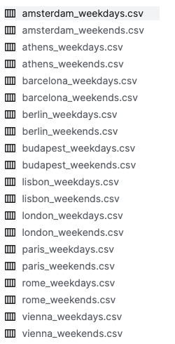

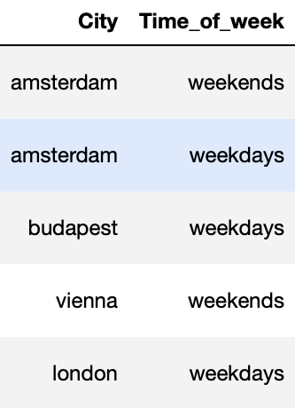
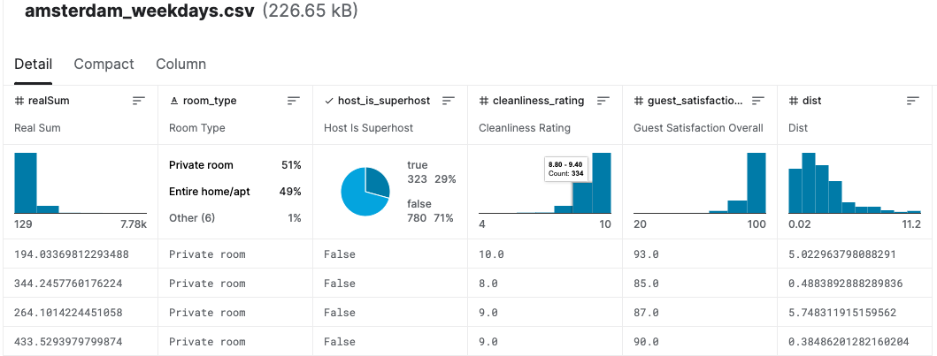
Introduction
Data
Source: Kaggle
This dataset provides a comprehensive look at Airbnb prices in some of the most popular European cities.
20 datasets
10 Cities across Europe
51, 707 Rows
15 columns
Dataset Transformation / Attribute Creation
I combined the 20 datasets in 1 dataset and created new attributes for city and time of week
Cities:
Amsterdam
Athens
Barcelona
Berlin
Budapest
Lisbon
London
Paris
Rome
Vienna
Time of Week
Weekdays
Weekends
Notes:
Why this dataset?
Why am I using User Profiles?

Slide 3
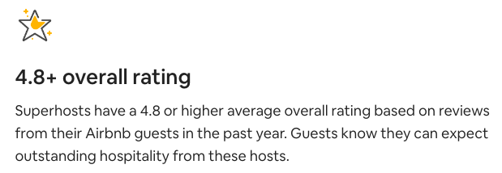
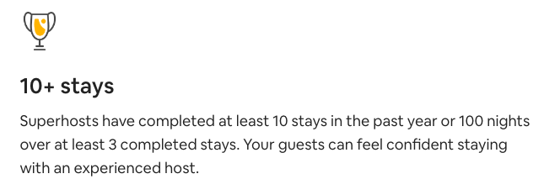
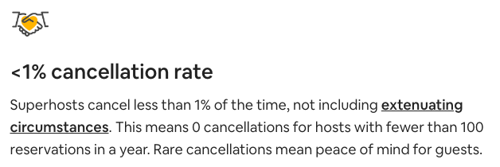
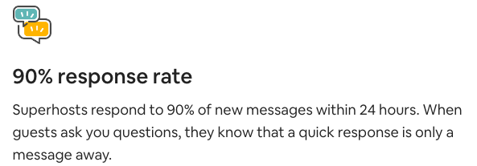
Dataset Attributes
Superhost status
Price (realSum) - The total price of the Airbnb listing. (Numeric)
Room Type (room_type) - The type of room offered (private, shared, entire home/apt). (Categorical)
Shared Room (room_shared) - Whether the room is shared or not. (Boolean)
Private Room (room_private) - Whether the room is private or not. (Boolean)
Capacity (person_capacity) - The maximum # of people that can stay in the room. (Numeric)
Superhost status (host_is_superhost) - Whether the host is a superhost or not. (Boolean)
Multiple Rooms (multi) - Whether the listing is for multiple rooms or not. (Boolean)
Business (biz) - Whether the listing is for business purposes or not. (Boolean)
Cleanliness (cleanliness_rating) - The cleanliness rating of the listing. (Numeric)
Satisfaction (guest_satisfaction_overall) - The overall guest satisfaction rating of the listing. (Numeric)
# of Bedrooms (bedrooms) - The number of bedrooms in the listing. (Numeric)
Distance to city center (dist) - The distance from the city centre. (Numeric)
Distance to train (metro_dist) - The distance from the nearest train station. (Numeric)
Longitude (lng) - The longitude of the listing. (Numeric)
Latitude (lat) - The latitude of the listing. (Numeric)
*New*
Time of Week (time_of_week) - The time of the listing (weekday, weekend). (Categorical)
City (city) - The city of the listing (Paris, Rome, Vienna etc.). (Categorical)
Notes:
This dataset provides a comprehensive look at Airbnb prices in some of the most popular European cities.
Each listing is evaluated for various attributes such as room types, cleanliness and satisfaction ratings, bedrooms, distance from the city centre, and more to capture an in-depth understanding of Airbnb prices on both weekdays and weekends. Using spatial econometric methods, we analyse and identify the determinants of Airbnb prices across these cities. Our dataset includes information such as realSum (the total price of the listing), room_type (private/shared/entire home/apt), host_is_superhost (boolean value indicating if host is a superhost or not), multi (indicator whether listing is for multiple rooms or not), biz (business indicator) , guest_satisfaction_overall (overall rating from guests camparing all listings offered by host ), bedrooms, dist (distance from city center) , lng & lat coordinates for location identification etc. We hope that this data set offers insight into how global markets are affected by social dynamics and geographical factors which in turn determine pricing strategies for optimal profitability!
How to become a Superhost -
The Superhost program celebrates and rewards Airbnb’s top-rated and most experienced hosts!
Every 3 months, we check if you’ve met the following criteria for the past year.* If you do, you'll earn or keep your Superhost status.
4.8+ overall rating - Superhosts have a 4.8 or higher average overall rating based on reviews from their Airbnb guests in the past year. Guests know they can expect outstanding hospitality from these hosts.
10+ stays - Superhosts have completed at least 10 stays in the past year or 100 nights over at least 3 completed stays. Your guests can feel confident staying with an experienced host.
Superhosts cancel less than 1% of the time, not including extenuating circumstances. This means 0 cancellations for hosts with fewer than 100 reservations in a year. Rare cancellations mean peace of mind for guests.
Superhosts respond to 90% of new messages within 24 hours. When guests ask you questions, they know that a quick response is only a message away.

Slide 4



How can Airbnb data inform travel plans?
(Living arrangement are just as important as what’s in the city)
User Profiles:
A- Michael - eccentric artist, germaphobe, likes staying close to the city center, likes a lot of space, loner who keeps to himself, has trust issues, no savings, only has time to travel during the weekends, very efficient with his time and doesn’t want to spend a lot of time commuting
B- Samantha - Tech professional, has a lot of money, likes to travel on the weekdays, mixes business with travel (visits her clients), prefers remote working, she is a big spender & attracted to luxury, but does what she can to give back to less fortunate because of her humble upbringing
C- Group of college students at Data Science Academy - traveling together in a co-ed/mixed gender fraternity, socially aware (some have rich parents but some do not), they prefer going out and drinking, like sticking together and going out in evenings with large groups of peers, spring break and summer trips
Notes:
Michael Lego - https://www.minifigures.com/products/michael.html
Michael is an eccentric artist who travels for inspiration. He likes staying close to the city center so that he can go to art events regularly. He doesn’t have a lot of money because his career hasn’t taken off yet.
He doesn’t get along well with others, so likes his own space. He needs a lot of space.
He has trust issues and needs a trustworthy host.
His artwork is sometimes messy, but he hates messes, he’s a germaphobe.
He wants to be efficient with his time, and doesn’t want to spend a lot of time commuting.
Samantha is a confident and powerful tech professional. She has a lot of money because of her long-standing career in tech.
She takes advantage of remote working flexibility that her job provides, so she travels on the weekdays.
She works for a global tech company with branches all over the world, so she likes to combine leisure and travel, often visiting her international clients to build closer relationships with them.
Since she lives an elite, privileged, and luxurious lifestyle, she does what she can to give back to the less fortunate.
Group of college students at Data Science Academy. They are dedicated to using AI to change the world, but are also rushed a fraternity to expand their network and have some fun. They travel together every spring break and summer. They are socially conscious. Some have rich parents, some do not. They try to make an effort to be more socially aware that they may have first-generation college students in their group.

Slide 5
General Findings

Slide 6
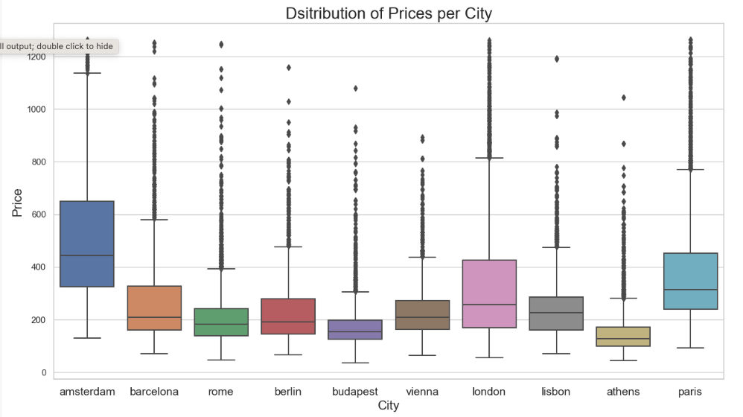
How do the listing prices compare across cities?
Notes:
Price is usually one of the most important factors when it comes to planning travel. As you can see, Amsterdam, Paris, and London have a higher median price (and greater spread) while Budapest and Athens are cheaper in general.

Slide 7
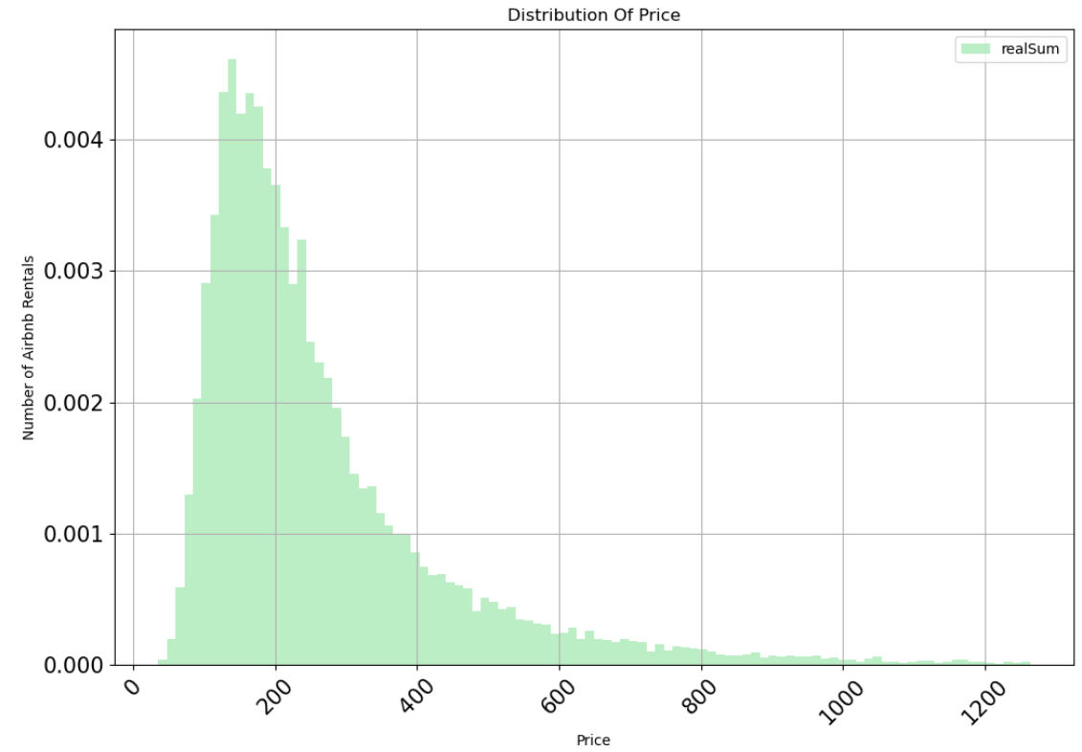
How do the listing prices compare across cities?

Slide 8
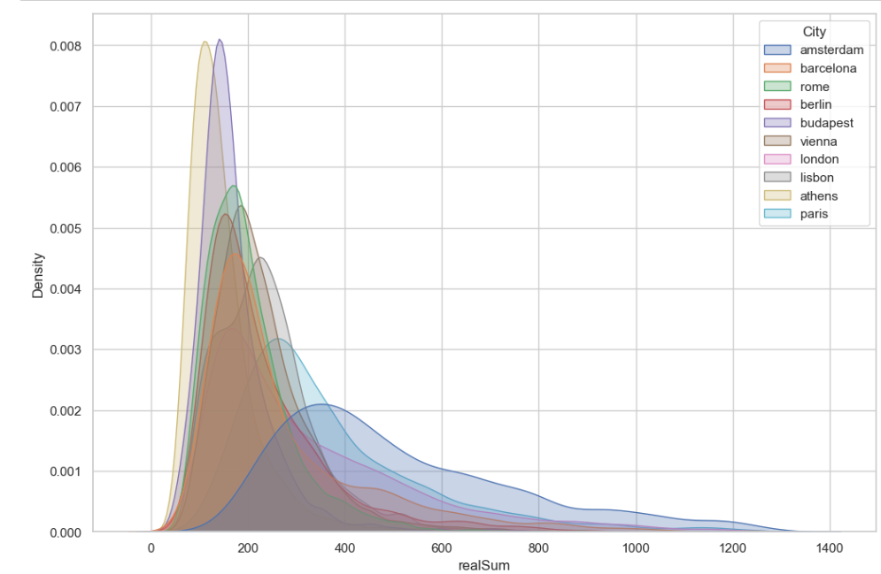
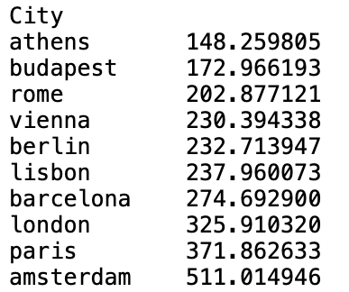
How do the listing prices compare across cities?
Notes:
To get a better look at the spread of the data, this density plot shows that Paris and Amsterdam have a much wider spread than cities such as Budapest and Athens. Cheaper options in places like Amsterdam might be a lot more competitive → Book earlier!
No shortage of low cost options in budapes and athens, so there’s more flexibility.

Slide 9
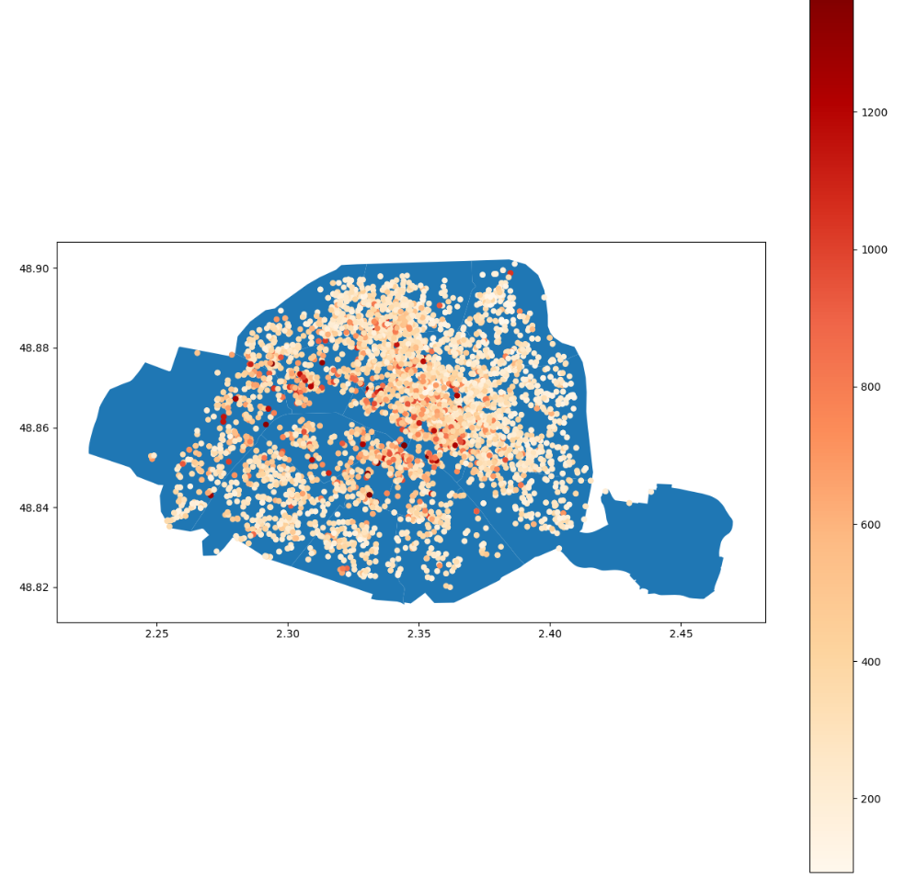
How does the listing price vary within each city?
Not only which city affects price, but where in the city
Notes:
The most expensive Airbnb rentals are in the center of the city.
In the 1st, 2nd, and 3rd arr.
If you want to live near the Seine, it’ll cost you, but there are plenty of parks on the outskirts.

Slide 10
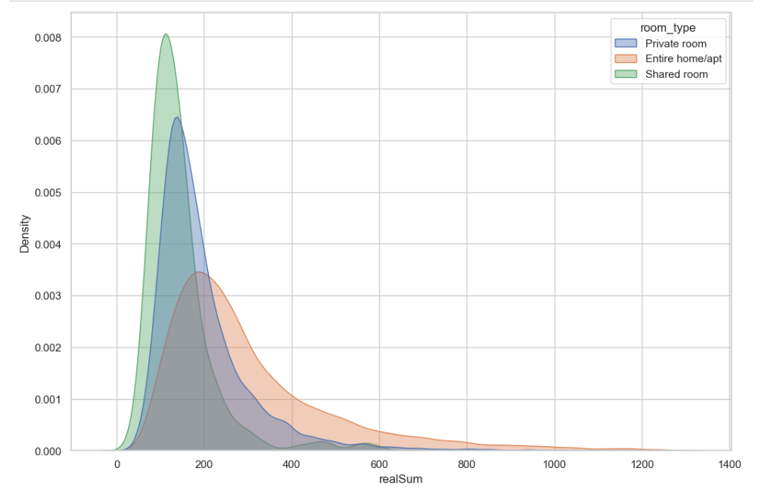
How does the type of room affect the price in general?
Notes:
Here you can see that shared rooms are centered around a lower price range than the Private Rooms and Entire home/apartment.
At the center of the distribution, prices are around 150 per night for private rooms
And there are outliers, really high prices more than 3 standards deviations away, all the way up to 1200 per night for an entire home/apt.

Slide 11
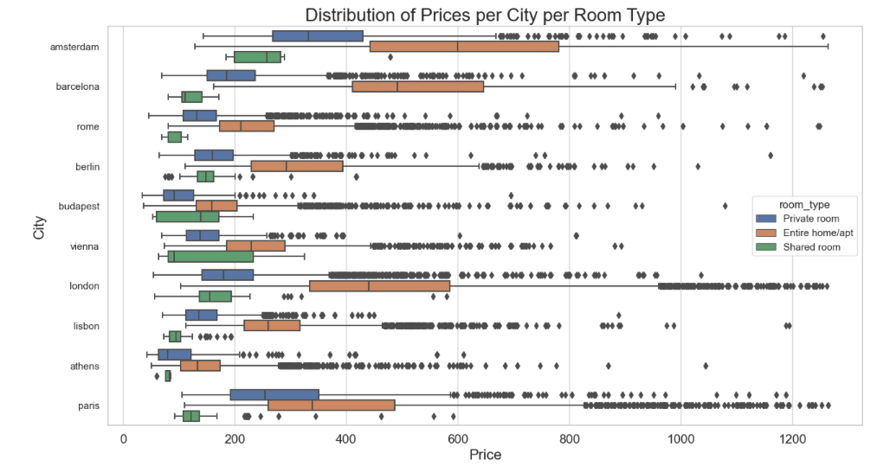
How does the type of room affect the price across cities?
Notes:
Another important factor, usually with strong preferences, is room type. As you can see here, Entire Room/Apt are generally more expensive, but in places like Budapest, an entire room isn’t much more expensive than the private room or shared room, while in London or Barcelona the entire home/apt median is more than twice as much as the next cheapest option.

Slide 12
How does the type of room affect the price across cities?
Notes:
Another important factor, usually with strong preferences, is room type. As you can see here, Entire Room/Apt are generally more expensive, but in places like Budapest, an entire room isn’t much more expensive than the private room or shared room, while in London or Barcelona the entire home/apt median is more than twice as much as the next cheapest option.
There are some places where the room type makes a big difference, and some where there isn’t a big difference.
In budapest you can get an entuore home and apartment for a little more than a shared room. The room type doesn’t matter as much in this city.

Slide 13
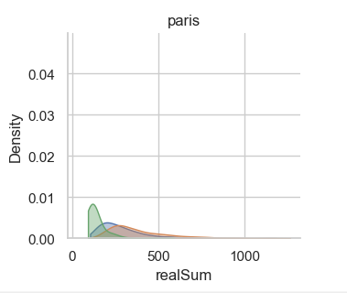
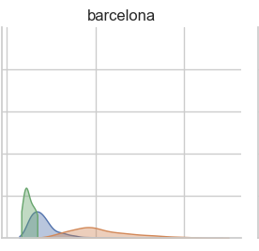
Price by City and Room Type
Notes:
Here you can see more closely that in Barcelona the median price is distributed.
But in Paris it’s skewed to the right, and the higher values are very rare and far from the center of the distribution, the right tail is a lot thinner and farther from the center.

Slide 14
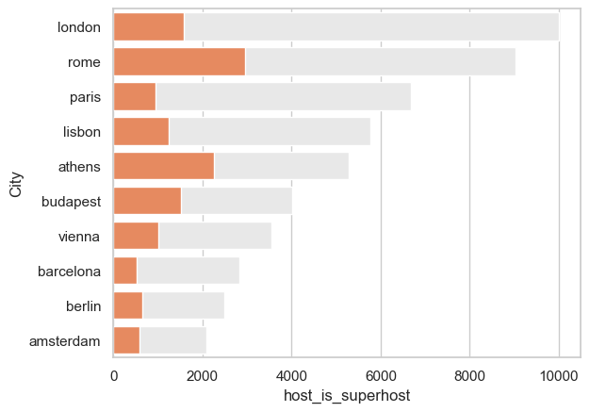
How do superhost ratings compare across cities?
London: 15.7%
Rome: 32.7%
Paris: 14.1%
Lisbon: 21.4%
Athens: 42.9%
Vienna: 28.4%
Barcelona: 18.1%
Berlin: 25.7%
Amsterdam: 28.4%
Notes:
To be a superhost, you have to:
4.8+ overall rating – gust satisfaction
10+ stays
<1% cancellation rate
90% response rate
The superhost status is very reliable.
If you want to have timely responses, avoid cancellation, choosing a location with a higher superhost ratio would help guarantee a good stay.
Athens has a large proportion of superhosts compared to total hosts. This suggests a higher rate of an accommodating, responsive, and hospitable stay compared to a place like London, where superhosts are more rare.

Slide 15
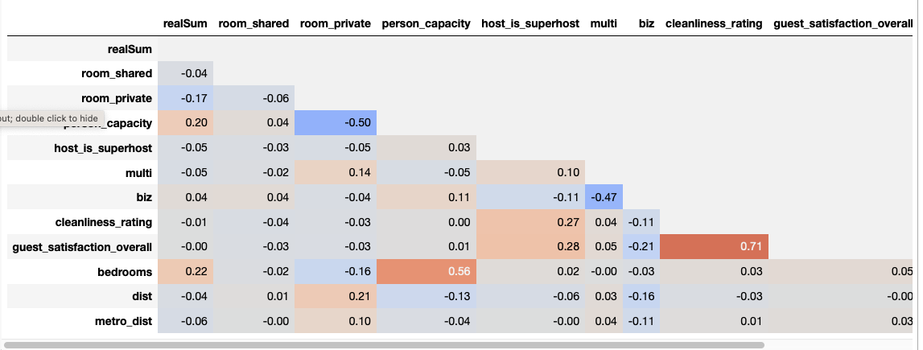
What other factors lead typically correlate with High Satisfaction Ratings?
Notes:
Cleanliness
As we can see, the guest satisfaction rating used to calculate the superhost rating, also has a strong positive correlation with the cleanliness rating.
It’s one of the highest correlations across the dataset.
That is another reason to stick with a higher rated host, if cleanliness is important to you.
Guest satisfaction correlates with cleanliness.

Slide 16
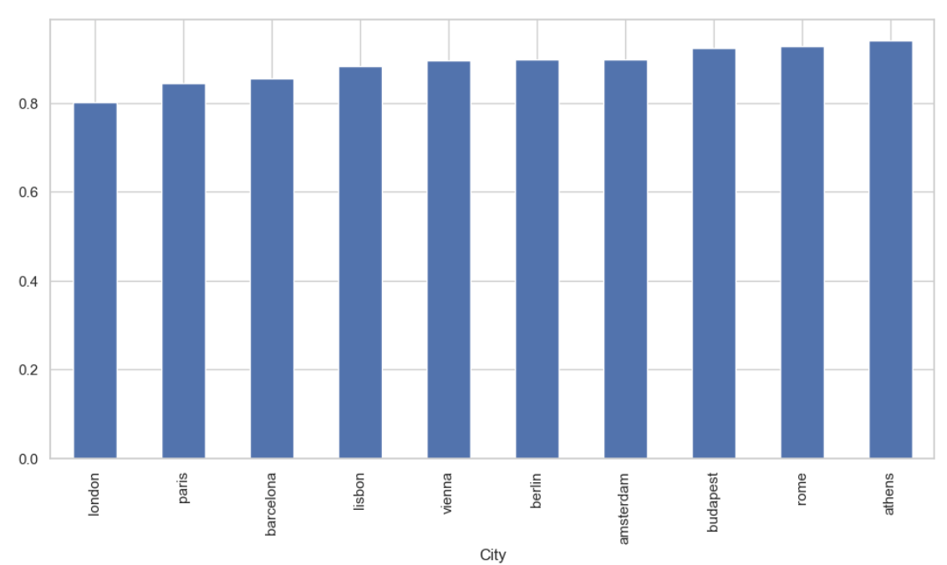
Which cities have the cleanest listings?
% Listings Cleanliness Ratings over 8
Notes:
The majority of 8, 9, and 10’s

Slide 17
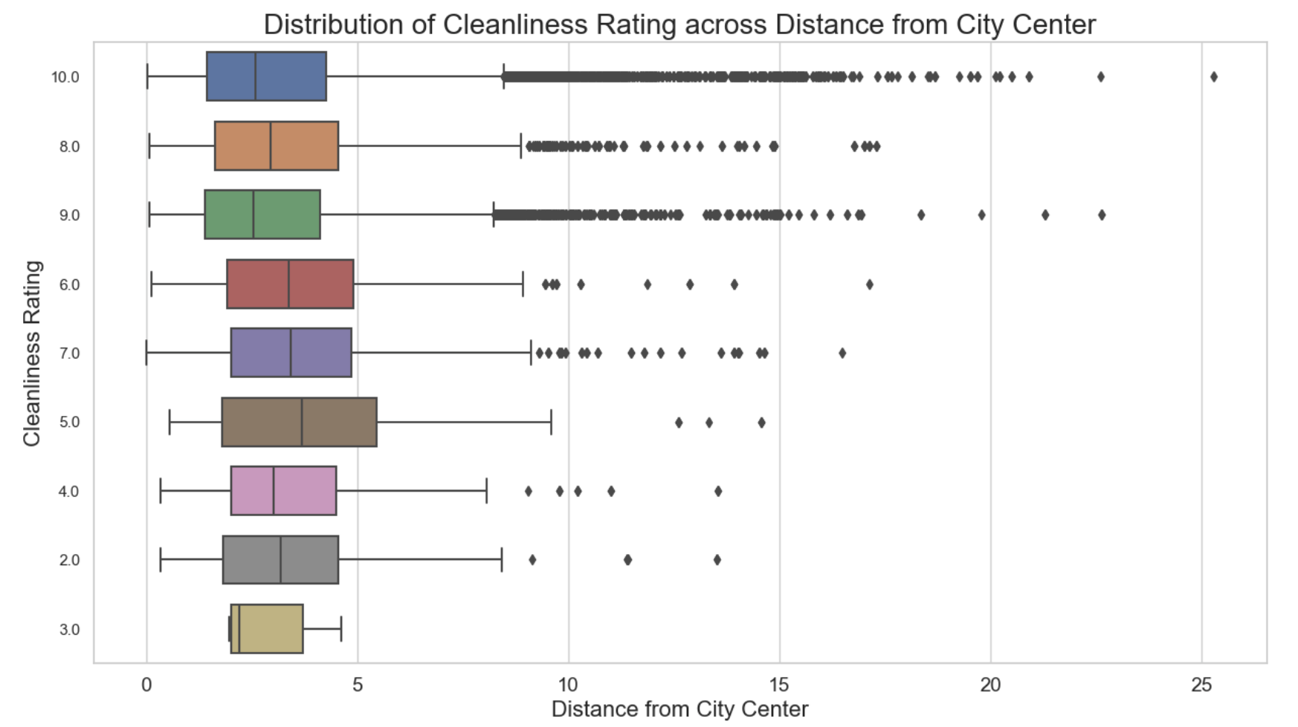
If you want a clean room…
Notes:
Typically, the cleanliness rating of the Airbnb has a positive relationship with the distance from the city center and the distance from the nearest metro station.
That could be because there’s less traffic, or because hosts who are not renting it the more touristic areas want to be competitive and attract guests.
So, you could sacrifice some cleanliness to be at the center of the city, or close to transportation, but typically the cleanest rentals are going to be farthest from the city center and nearest subway.
=========
Under 9 miles from the city center, the cleanliness of the rooms are pretty similar, but if you go farther out past 10 miles, you have a greater chance of finding a cleaner room.
Berlin 25 miles

Slide 18
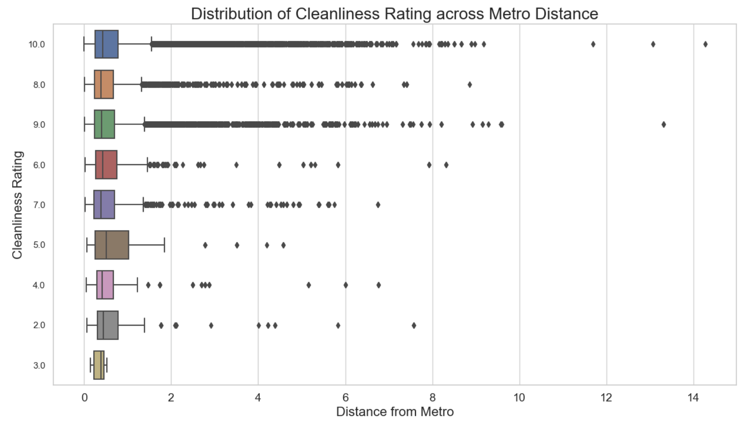
If you want a clean room…

Slide 19
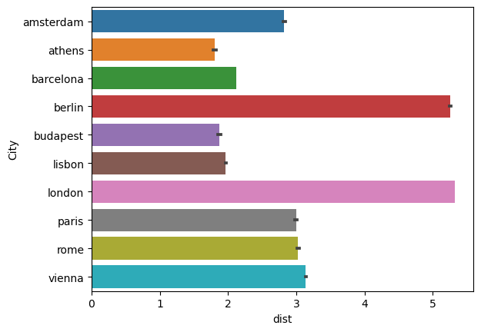
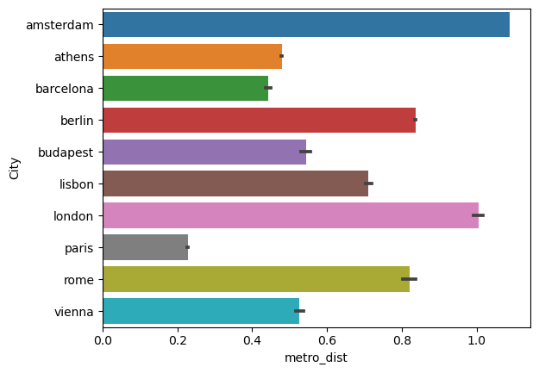
Where? Close to the metro? Close to City Center?
Notes:
Chart 1:
Paris is connected and Amsterdam is not.
Berlin and london, the rentals are spread out, and extend far from the city center.
This could be because the city is bigger.
Athens, budapest, Lisbon are more concentrated towards the center.
This could be because the cities are smaller.
So if you want to a guarantee to be close to the nearest metro, or will rely on that, choose paris.
If you’ll be biking or use another form of transportation, go with amsterdam.
Chart 2:

Slide 20
Where? Close to the metro? Close to City Center?
Notes:
Chart 1:
Paris is connected and Amsterdam is not.
Berlin and london, the rentals are spread out, and extend far from the city center.
This could be because the city is bigger.
Athens, budapest, Lisbon are more concentrated towards the center.
This could be because the cities are smaller.
So if you want to a guarantee to be close to the nearest metro, or will rely on that, choose paris.
If you’ll be biking or use another form of transportation, go with amsterdam.
Chart 2:

Slide 21
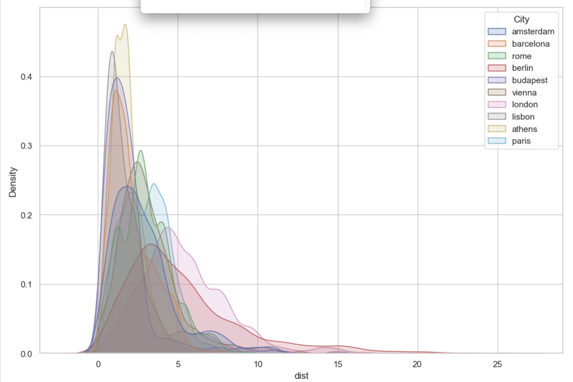
Where? Close to the metro? Close to City Center?

Slide 22
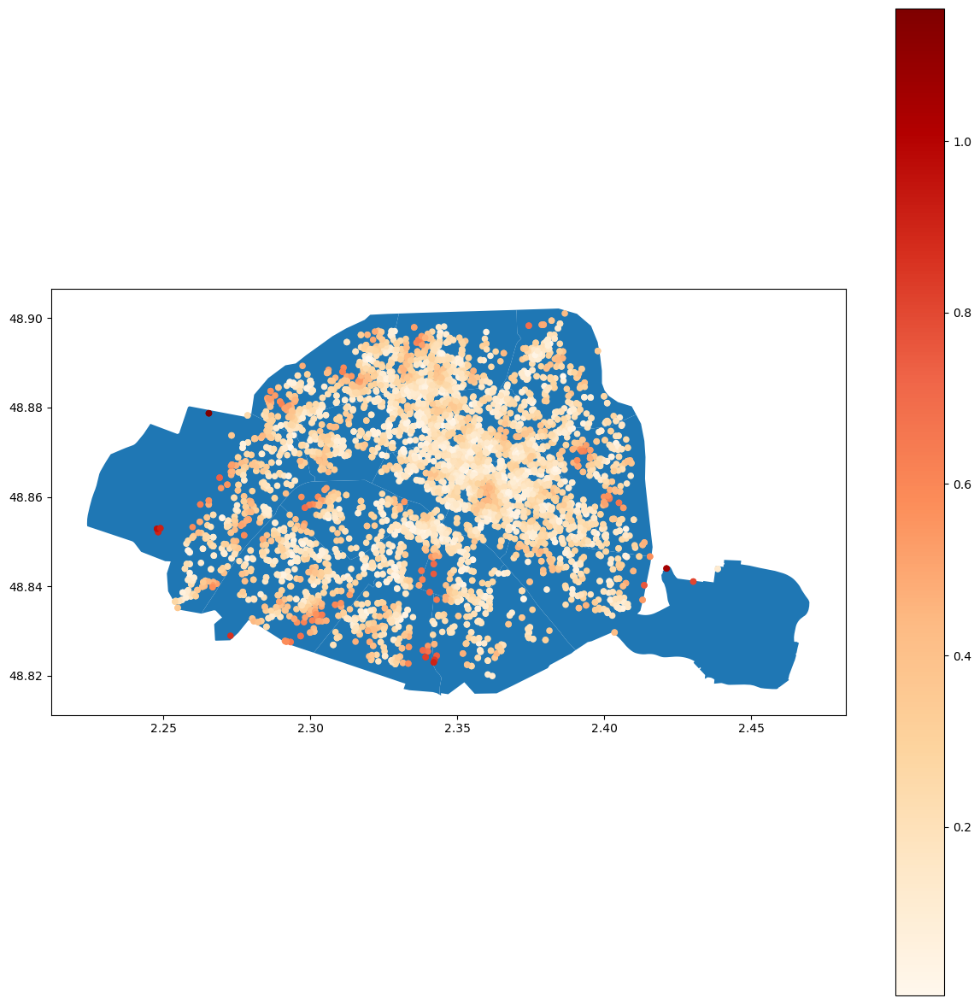
How does that look geographically?
Paris
- Distance from closest metro station increases on the outskirts of Paris
Notes:
Here you can see, as the distance away from the center increases, the distance from the metro increases.
The rentals farthest from the center are darker red.

Slide 23
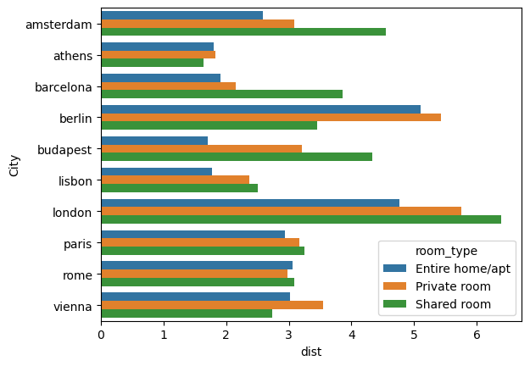
Where are room types located in the city?
Notes:
Paris, Rome, Vienna, and Athens, the room type are equidistant from the city center.
But, Budapest, Amsterdam, barcelona, and berlin, show a trend:
Budapest, Amsterdam, & Barcelona, the shared rooms are much farther out.
Budapest - entire home is closest to center
Barcelona - shared rooms are farthest from city center – but closer to the beach.
In Berlin, the shared rooms are closer to city center than private rooms and entire home/apt.
In Berlin, you could probably get a cheap shared room, and still be in the center/tourist area.
But in barcelona you could be close to the beach for cheap.
In London, your shared room is going to be farther out from the city center
AVERAGE DISTANCE

Slide 24
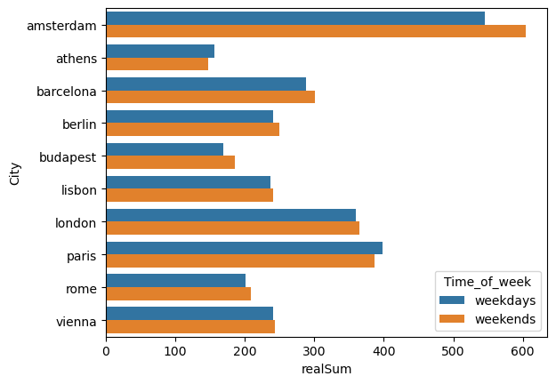
When? Weekend vs Weekday..
Notes:
If going on a multi-city trip and you want to go to either Athens or Paris, you can save some money by going to Athens or Paris on the weekend, where rates are cheaper than weekdays. All of the other cities on average are more expensive during the weekends.

Slide 25
Quick Note: General relationships/correlations (How does each city stand out?)
Athens: Cleanest city, cheapest city
Athens is great for a solo traveler who doesn’t have much time to walk around a lot. Because it’s small, it’s easy to get to the city center, and there’s always a metro nearby. It also has the most superhosts.
Paris: most well connected, expensive options!
Barcelona: In Barcelona, the rooms closest to the beach are…
The most expensive, but they are available on the weekday
Amsterdam: less well connected via subway, most expensive
Berlin: Shared rooms closer to city center! The rooms in the city center aren’t as cheap as the rooms on the outskirts, but they are all clean.
Lisbon: In Lisbon, the rooms are the cheapest, but also have lower cleanliness ratings than the other cities.
Vienna: The highest prices, the cleanest rooms for the lowest price, the highest rated shared rooms

Slide 26
High Cleanliness Rating Percentage by City
% Listings Cleanliness Ratings over 8
Notes:
The majority of 8, 9, and 10’s

Slide 27
Price by City and Room Type
Notes:
Another important factor, usually with strong preferences, is room type. As you can see here, Entire Room/Apt are generally more expensive, but in places like Budapest, an entire room isn’t much more expensive than the private room or shared room, while in London or Barcelona the entire home/apt median is more than twice as much as the next cheapest option.

Slide 28
Prices
Notes:
Price is usually one of the most important factors when it comes to planning travel. As you can see, Amsterdam, Paris, and London have a higher median price (and greater spread) while Budapest and Athens are cheaper in general.

Slide 29
Recommendations

Slide 30
Michael (Search Criteria)
Price Conscious
Cleanliness
Trusted host
Notes:
I would recommend that Michael travel to Athens because Athens has

Slide 31
Michael
Recommendation: Athens!
Price Conscious
Lowest Average Median price
London: 15.7%
Rome: 32.7%
Paris: 14.1%
Lisbon: 21.4%
Athens: 42.9%
Vienna: 28.4%
Barcelona: 18.1%
Berlin: 25.7%
Amsterdam: 28.4%
Notes:
I would recommend that Michael travel to Athens because Athens has

Slide 32
Samantha (Search Criteria)
Price & Public Transportation Agnostic
Hosts have room for improvement
Notes:
Price Agnostic
As a high-powered tech executive who comes from humble background, Samantha loves to spend her hard-earned money.
She revels in having a luxurious lifestyle, is quite indulgent, and bougie.
She is price agnostic because of her net-worth, but leans into spending more because she can!
Even though Samantha is part of the elite, she is often doing what she can to make the system fair for others and likes giving underdogs a fair shot to prove themselves.
She thinks the superhost system is elitist, and wants to give opportunities to inexperienced hosts and lower rated hosts.
Paris was my hypothesis because I love paris, it could be a perfect fit for her, but the data didn’t support that!

Slide 33
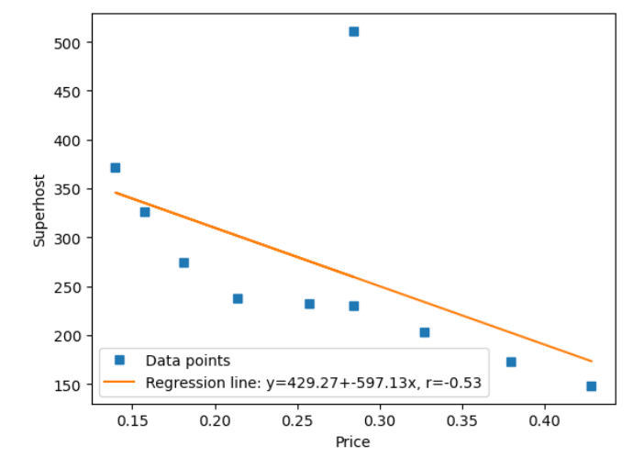
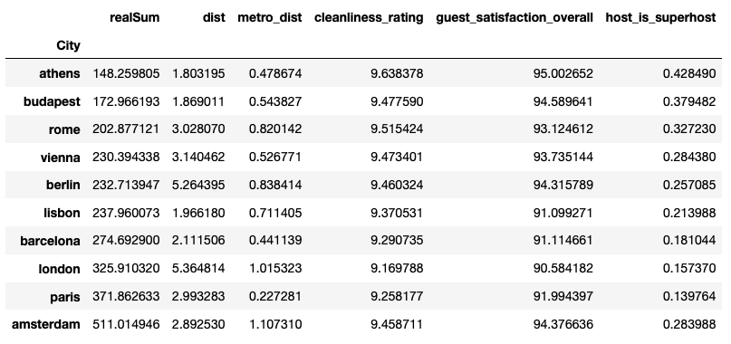
Samantha (Search Criteria)
Price & Public Transportation Agnostic
Hosts have room for improvement
Notes:
Price Agnostic
As a high-powered tech executive who comes from humble background, Samantha loves to spend her hard-earned money.
She revels in having a luxurious lifestyle, is quite indulgent, and bougie.
She is price agnostic because of her net-worth, but leans into spending more because she can!
Even though Samantha is part of the elite, she is often doing what she can to make the system fair for others and likes giving underdogs a fair shot to prove themselves.
She thinks the superhost system is elitist, and wants to give opportunities to inexperienced hosts and lower rated hosts.
Paris was my hypothesis because I love paris, it could be a perfect fit for her, but the data didn’t support that!

Slide 34
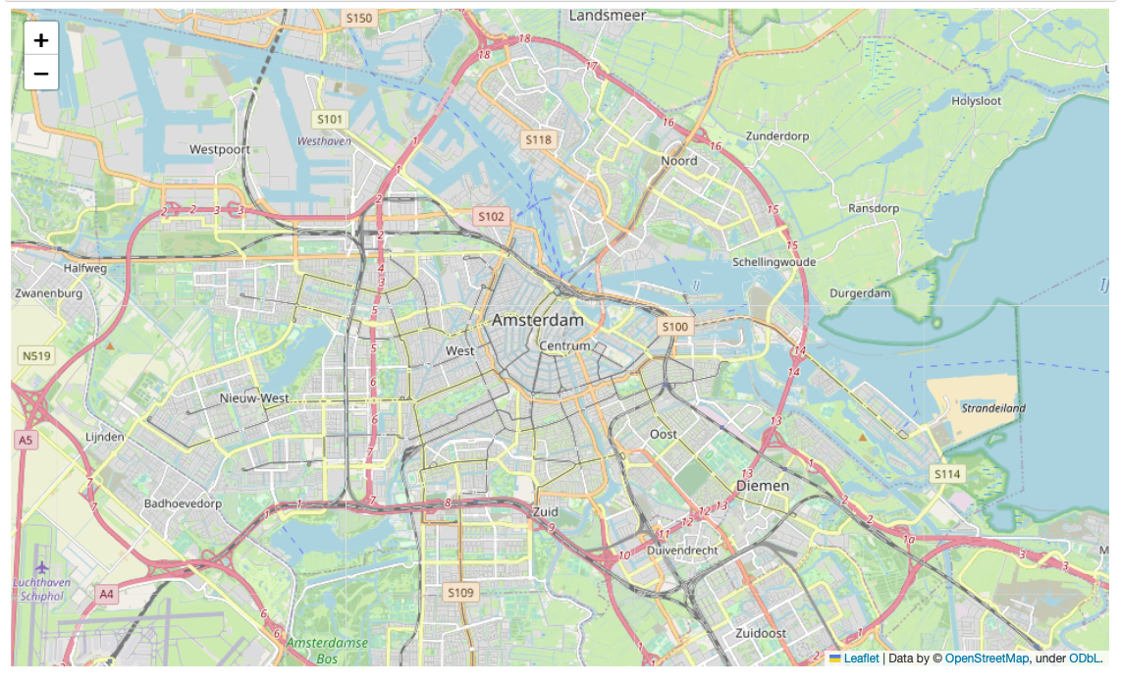
Amsterdam vs. Paris
Paris is very commutable via metro
Amsterdam is very commutable via car

Slide 35
Samantha
Recommendation: Amsterdam!
Price Agnostic
Amsterdam has the most expensive accommodation, highest average median price, after Paris.
Doesn’t need to be close to metro because she can uber everywhere!
Hosts have room for improvement
Superhost system provides a good opportunity to give back
Believes the Airbnb superhost system is elitist and she wants to give opportunities to inexperienced hosts.
Paris was my hypothesis, but the data didn’t support that!
Notes:
Price Agnostic
As a high-powered tech executive who comes from humble background, Samantha loves to spend her hard-earned money.
She revels in having a luxurious lifestyle, is quite indulgent, and bougie.
She is price agnostic because of her net-worth, but leans into spending more because she can!
Even though Samantha is part of the elite, she is often doing what she can to make the system fair for others and likes giving underdogs a fair shot to prove themselves.
She thinks the superhost system is elitist, and wants to give opportunities to inexperienced hosts and lower rated hosts.

Slide 36
Group of College Students (Search Criteria)
Proximity to city center
Entire home and apartment options
Price Flexibility
Notes:
Proximity to city center
They like to stick together…
Traveling in large groups is often easier by foot or metro than taking a taxi
They’ll be able to bar hop more easily by foot or by metro with only a few stations in between destinations
They like staying out late…
They can make it to and from nightlife more quickly/efficiently
They prefer drinking as a social activity…
Sometimes college students make the mistake of drinking more than they should - they are close to home in case someone becomes too intoxicated and has to make it back quickly
If a student drinks too much too quickly, their peers can make it back to their place to support them
Entire home and apartment options
Maintain sense of togetherness - they might have lived in fraternity housing together and would like to keep the same routines of pre-partying, departing together, and coming back home together.
Large space to hang out together with many people
Price Flexibility
Data on the price distribution has shown that budapest is the second cheapest city, after Athens.
Affordable options for students who might want their own space
Interesting insight!
aTHENS looks cheaper for entire home/ apt, but when i filter less than 1 miile towards city center, budapest has cheaper options

Slide 37
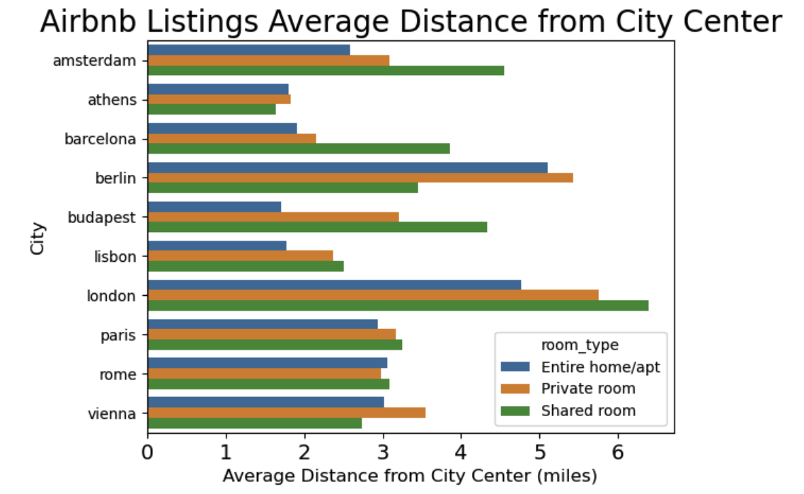
Where are room types located in each city?
Notes:
Paris, Rome, Vienna, and Athens, the room type are equidistant from the city center.
But, Budapest, Amsterdam, barcelona, and berlin, show a trend:
Budapest, Amsterdam, & Barcelona, the shared rooms are much farther out.
Budapest - entire home is closest to center
Barcelona - shared rooms are farthest from city center – but closer to the beach.
In Berlin, the shared rooms are closer to city center than private rooms and entire home/apt.
In Berlin, you could probably get a cheap shared room, and still be in the center/tourist area.
But in barcelona you could be close to the beach for cheap.
In London, your shared room is going to be farther out from the city center
AVERAGE DISTANCE

Slide 38
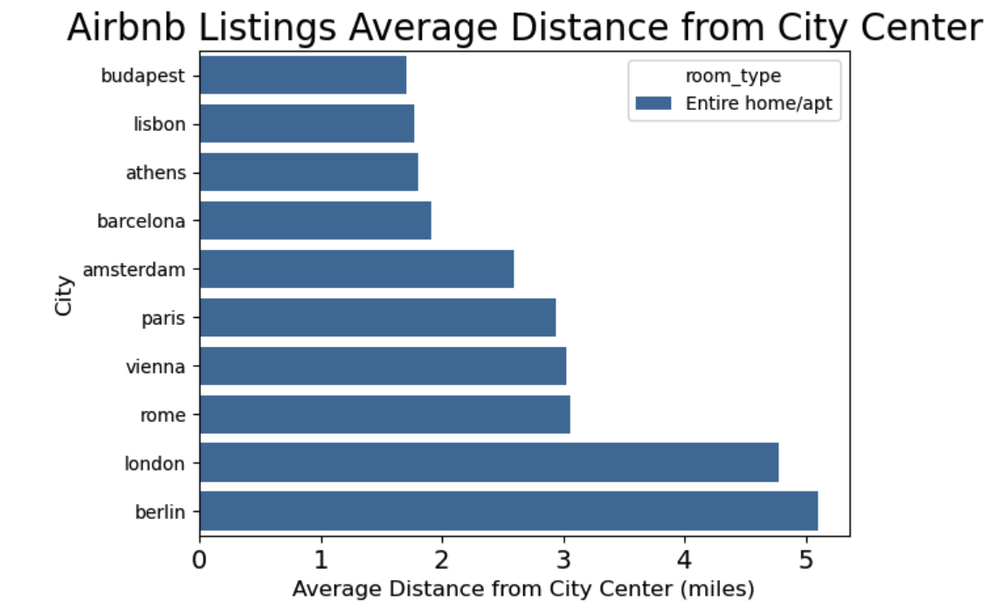
Where are entire home/apt listings closest to the center?
Notes:
Paris, Rome, Vienna, and Athens, the room type are equidistant from the city center.
But, Budapest, Amsterdam, barcelona, and berlin, show a trend:
Budapest, Amsterdam, & Barcelona, the shared rooms are much farther out.
Budapest - entire home is closest to center
Barcelona - shared rooms are farthest from city center – but closer to the beach.
In Berlin, the shared rooms are closer to city center than private rooms and entire home/apt.
In Berlin, you could probably get a cheap shared room, and still be in the center/tourist area.
But in barcelona you could be close to the beach for cheap.
In London, your shared room is going to be farther out from the city center
AVERAGE DISTANCE

Slide 39
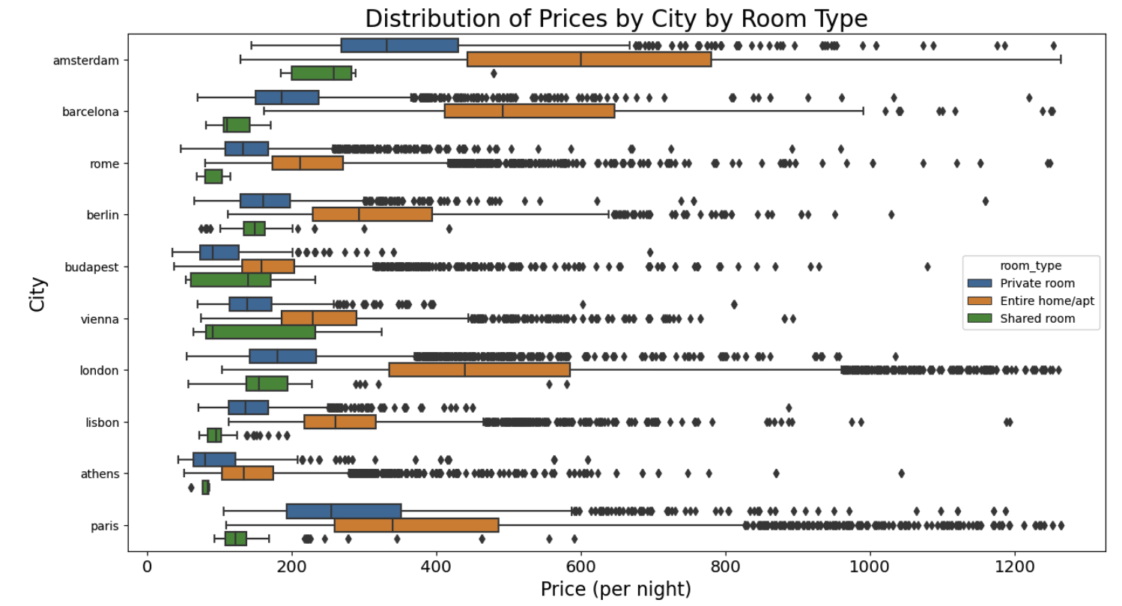
What is the price of a room based on its city and type?
Notes:
Another important factor, usually with strong preferences, is room type. As you can see here, Entire Room/Apt are generally more expensive, but in places like Budapest, an entire room isn’t much more expensive than the private room or shared room, while in London or Barcelona the entire home/apt median is more than twice as much as the next cheapest option.

Slide 40
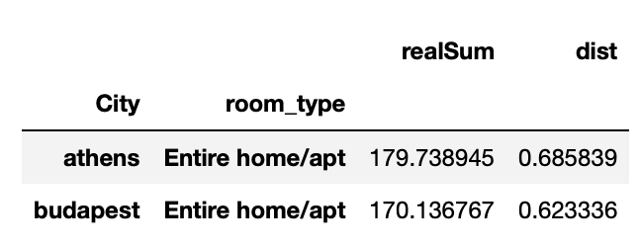
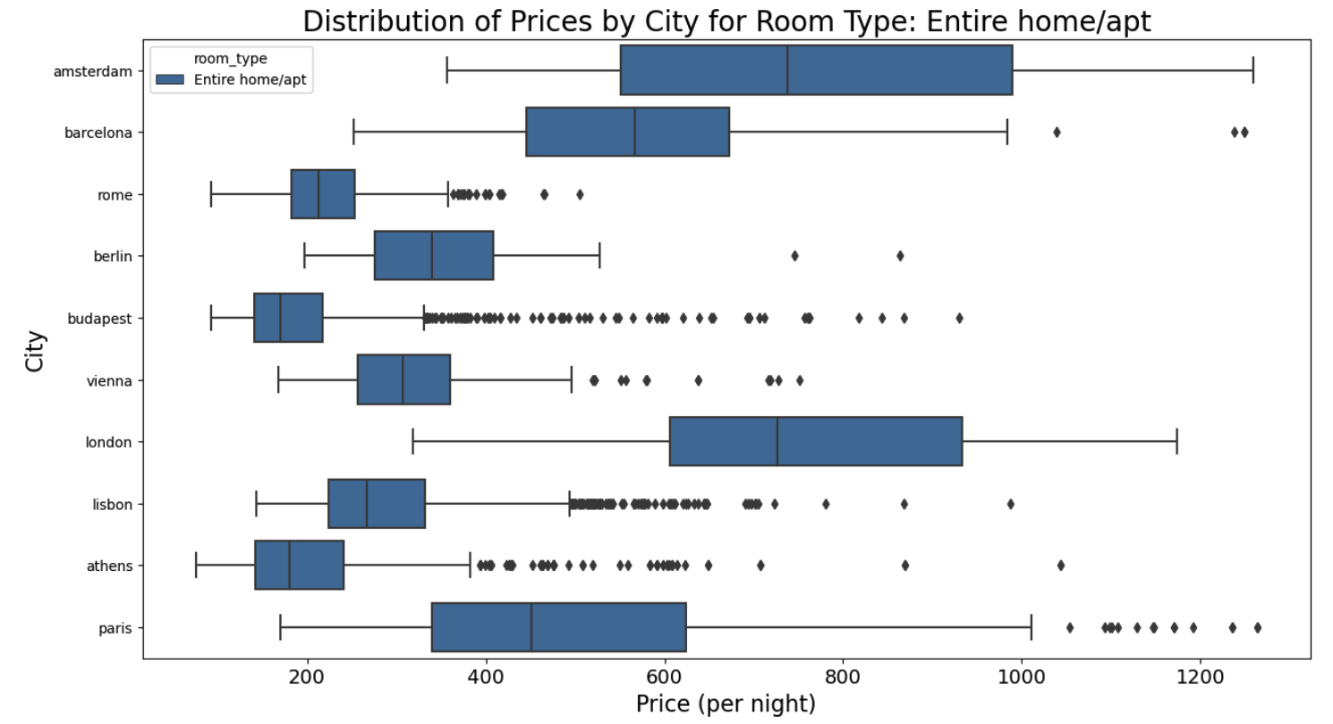
Entire home/apt <1 mile from city center
Budapest lowest median price & shortest distribution
Notes:
Median being slightly lower and a smaller distribution

Slide 41
Group of College Students
Recommendation: Budapest!
Proximity to city center
Bar hopping and moving around by foot
Public Transportation
Nightlife (Going out and staying out late)
Meet other young people
Entire home and apartment options
Walking
Drink a lot
Space to hang out in large groups
Price Flexibility
Affordable for everyone! Little variation in the price per room type
Students with less financial support who might want to stay alone or be in shared room have that option
Cheap Beer
Notes:
Proximity to city center
They like to stick together…
Traveling in large groups is often easier by foot or metro than taking a taxi
They’ll be able to bar hop more easily by foot or by metro with only a few stations in between destinations
They like staying out late…
They can make it to and from nightlife more quickly/efficiently
They prefer drinking as a social activity…
Sometimes college students make the mistake of drinking more than they should - they are close to home in case someone becomes too intoxicated and has to make it back quickly
If a student drinks too much too quickly, their peers can make it back to their place to support them
Entire home and apartment options
Maintain sense of togetherness - they might have lived in fraternity housing together and would like to keep the same routines of pre-partying, departing together, and coming back home together.
Large space to hang out together with many people
Price Flexibility
Data on the price distribution has shown that budapest is the second cheapest city, after Athens.
Affordable options for students who might want their own space
Interesting insight!
aTHENS looks cheaper for entire home/ apt, but when i filter less than 1 miile towards city center, budapest has cheaper options

Slide 42
Have a good trip!
bon voyage!
¡buen viaje!
Gute Reise!
buon viaggio!
bon viatge!
goede reis!
boa Viagem!
Kaló taksídi!
jó utat!

Slide 43
Where should YOU travel?
You should travel to…
Standards:
If you’re on a budget: Lisbon, Rome, Budapest are cheapest, Not Athens & Paris & London! Travel on the weekend.
If cleanliness matters to you: London, Rome, and Paris are the cleanest, unsurprisingly. Or Rent an Entire home/apt!
If you want a trusted host: Go to Rome! Rome has the highest %Superhosts to total listing out of all cities. In Athens, half are super!
If you want a guaranteed satisfaction:
When:
If you’re traveling on the weekday: Amsterdam and Barcelona are more expensive on the weekends
If you’re traveling on the weekend: Paris and athens are more expensive on the weekdays
Where:
If you want to be close to a metro station: Amsterdam and london have the highest distance from metro
If you want to be close to the city center: Athens & Paris – Not Berlin or London!
With who:
If you’re traveling alone and want privacy: in berlin, the private rooms are farthest from the city center
If you’re traveling alone and want to meet locals or other travelers: in london, the shared rooms are the farthest from the city center
If you’re traveling with a group: Avoid Amsterdam! The entire home/apt is the most expensive. Go Budapest!
Notes:
Travel Recommendation List
This is valuable to people who want to travel

